Slide 1
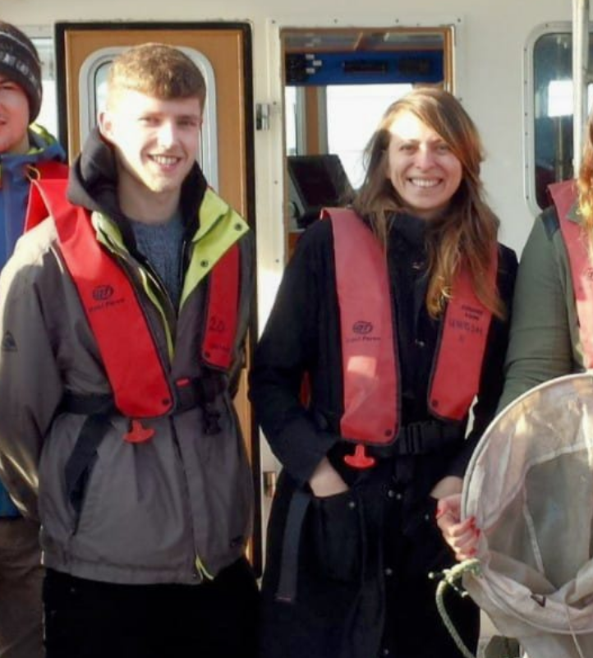




Calum Young
BSc (Hons) Freshwater and Marine Biology – UoG
MSc Marine Biology – Stockholm University
PhD Marine Ecology – UoG (Started November 2024)
ca. 2016
2013 - 2017
2018 - 2021
2024 -
Notes:
So just to give you a little introduction, I started my studies at Glasgow university where I completed a undergrad in Freshwater and marine biology.
I then went onto Stockholm University where I completed a masters in marine biology, where first got involved using eDNA during my thesis looking at phytoplankton seasonality in galapagos mangroves.
In November last year, I returned to Glasgow university after a few side quests growing oysters and rescuing sea turtles where I am now a first year phd student the project of which I am going to introduce to you

Slide 2
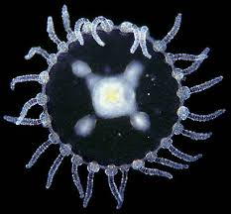
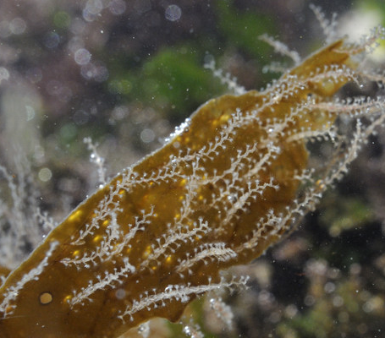
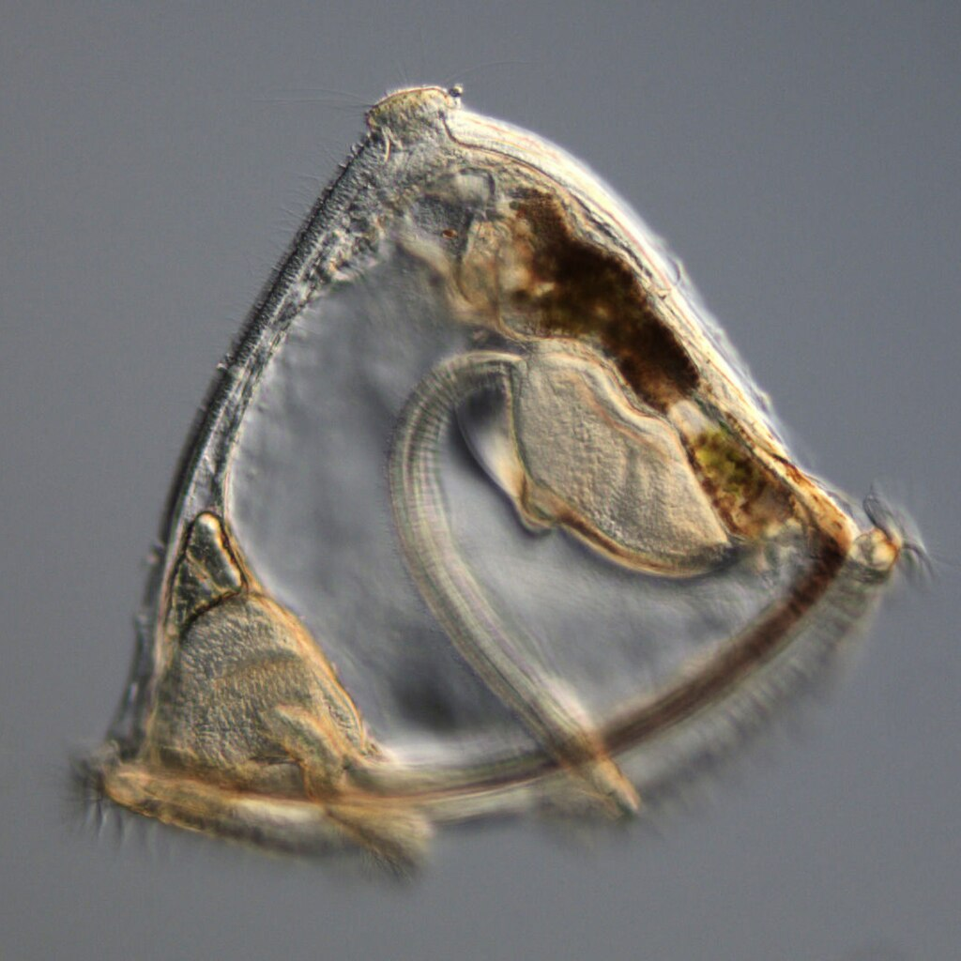
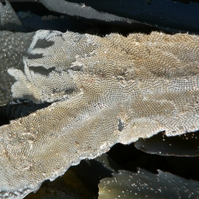
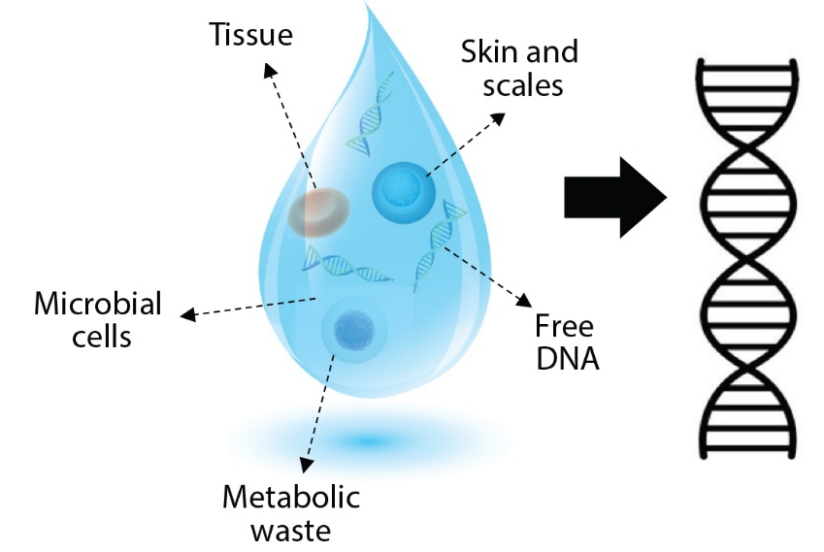
Seaweed Epibionts / Biofouling Species
Aim: Optimise eDNA as an early warning system for biofouling in seaweed aquaculture.
Obelia sp. Medusa
Obelia dichotoma
eDNA: Environmental DNA
Bryozoan mat : M. membranacea (biofouling)
Bryozoan cyphonaute
Notes:
Once established on the frond - species and can quickly proliferate and cover much if not off the seaweed blade with a matter of months depending on the species and conditions.
https://www.ispotnature.org/communities/uk-and-ireland/view/observation/136907/hydroid-colonies-attached-to-kelp-frond-

Slide 3
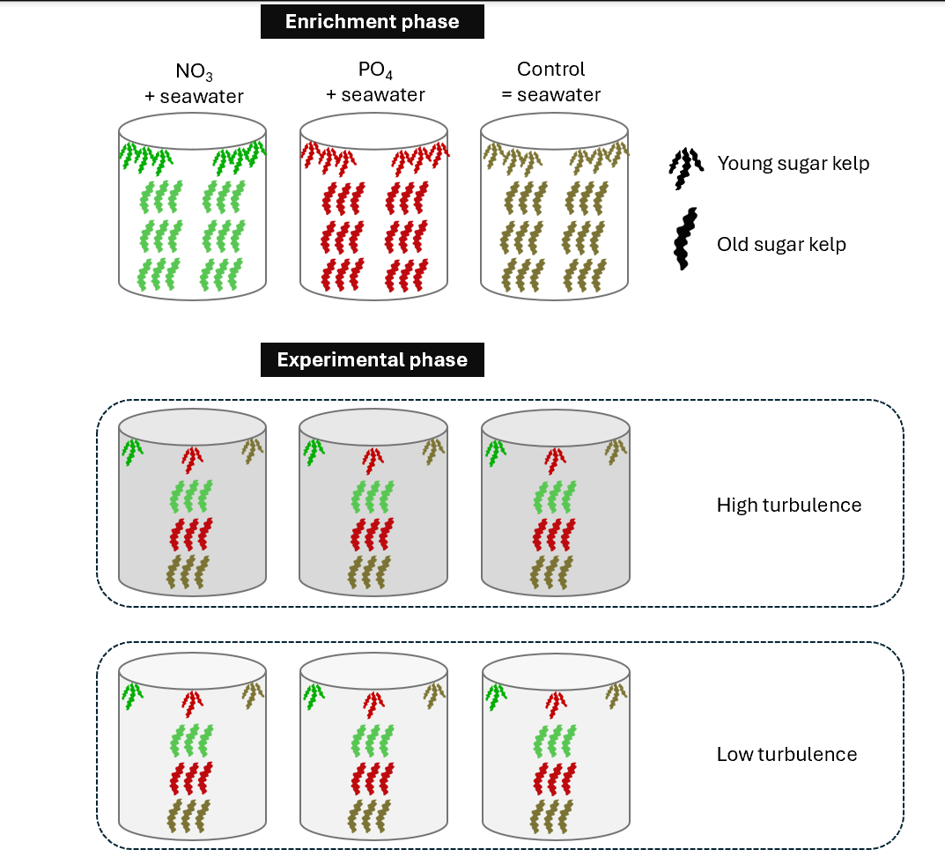
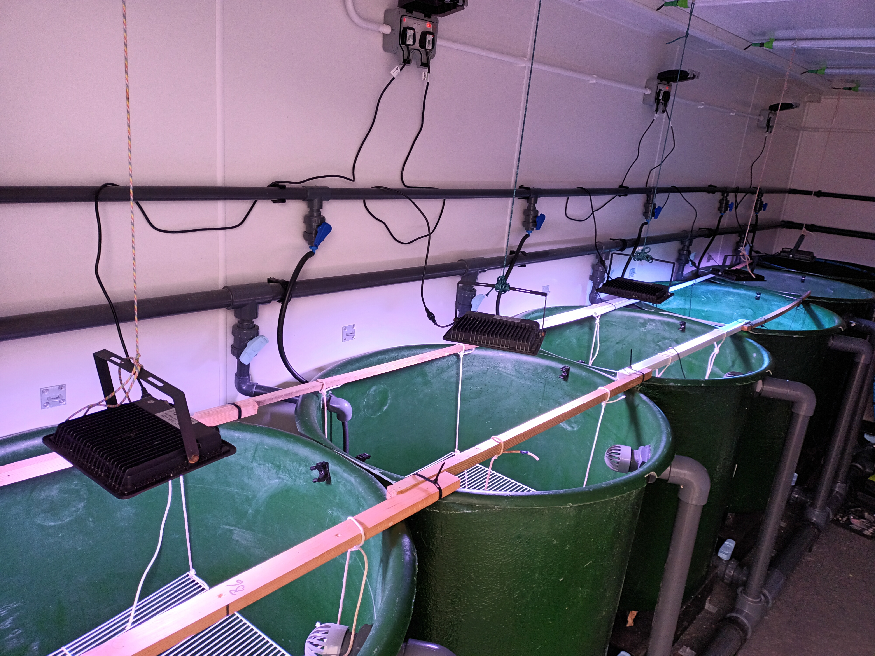
Mesocosm:
Nutrient enrichment / Turbulence
Mesocosm set-up at Millport

